Slide 1

HAFIZ BILAL QAMAR 2024-MSDS-101
GOOGLE PLAYSTORE
By :
SIR DR M AWAIS

Slide 2
1. Problem Definition
Problem:
Use the Google Play Store dataset to understand app performance and user preferences.
Objective:
Predict app ratings and identify key factors influencing them.
Significance:
Businesses can improve app quality and user satisfaction by understanding these factors.

Slide 3
2. Asking the Right Questions
Does the number of reviews correlate with an app's rating or popularity?
What is the relationship between the app price and its rating?
How does app size affect its rating and installs?
Do certain categories consistently achieve higher ratings or more downloads?
How does content rating (e.g., Everyone, Teen, Mature) influence app popularity and ratings?

Slide 4
3. Data Collection
Understanding Data Types: In our dataset, we have various data types:
Numeric (e.g., Reviews, Rating): Quantitative data for calculations and statistics.
Categorical (e.g., Category, Type): Grouping variables for analysis.
Text (e.g., App, Genres): Free-form data often requiring cleaning.
Datetime (e.g., Last Updated): Requires conversion for analysis.
Structures and Workflows:
Structure: The dataset is in tabular format with rows (records) and columns (fields).
Workflow: Load the dataset, clean it, and analyze trends like the relationship between app categories and average ratings.

Slide 5
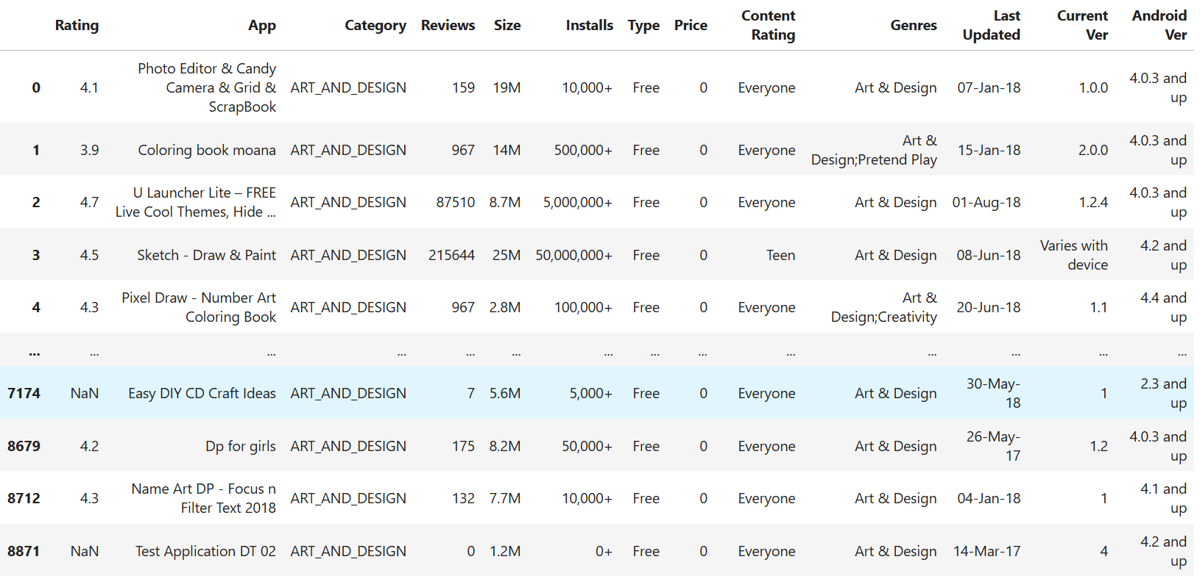
df =pd.read_csv("googleplaystore.csv") df.head()

Slide 6



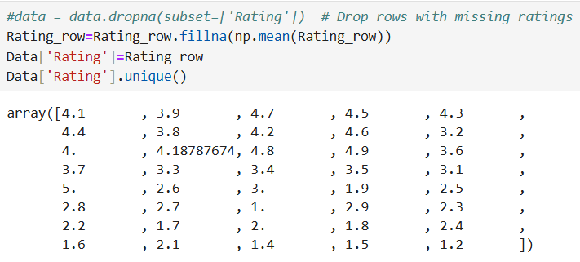
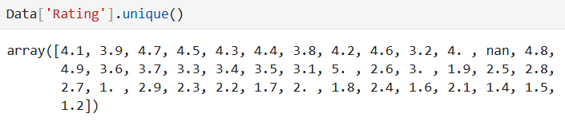
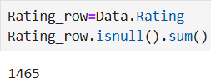
4. Data Wrangling and Cleaning
Definition: Transforming raw, unstructured data into a usable format.
Identify Issues and Clean Data:
Handle Missing Values: Remove or impute missing entries.
Standardize Columns: Convert Installs and Price into numerical values.
Normalize Numerical Columns: Standardize Reviews and Size for model compatibility.
Convert "Installs" and "Price" to numeric by removing symbols like "$" and "+".
•Example of Drop:
Before Drop Dublicates Drop Dublicates After Drop
Example of Replace by Mean value

Slide 7
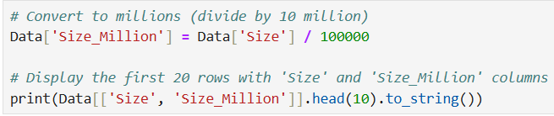
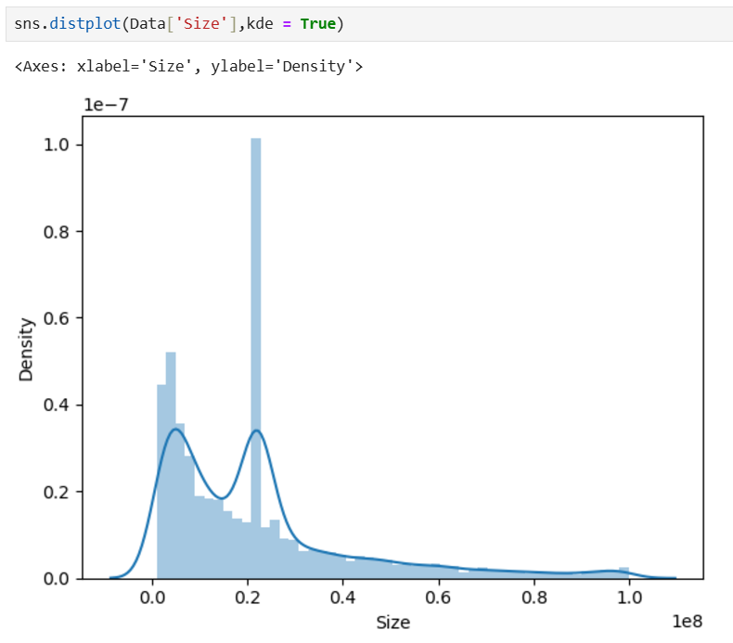
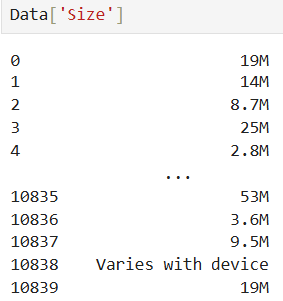
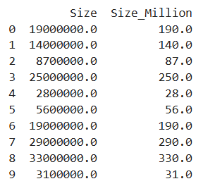

Slide 8
5. Exploratory Data Analysis (EDA)
Understanding Data Distribution
Visualize the distribution of key numerical columns like Rating, Installs, and Reviews using histograms or KDE plots.
Identify skewness, outliers, and range of values.
Relationship Between Features
Use scatter plots or pairplots to explore relationships, e.g., between Rating and Reviews.
Correlation heatmaps show linear relationships between numerical features.
Category-Based Analysis
Analyze categorical columns (e.g., Category, Type) to compare group-wise averages or counts.
Bar plots and box plots are useful for this.
Identify Outliers
Use box plots to detect outliers in columns like Rating and Reviews.
Feature Interactions
Explore combined effects of features, such as Price and Installs, on the target variable Rating.

Slide 9
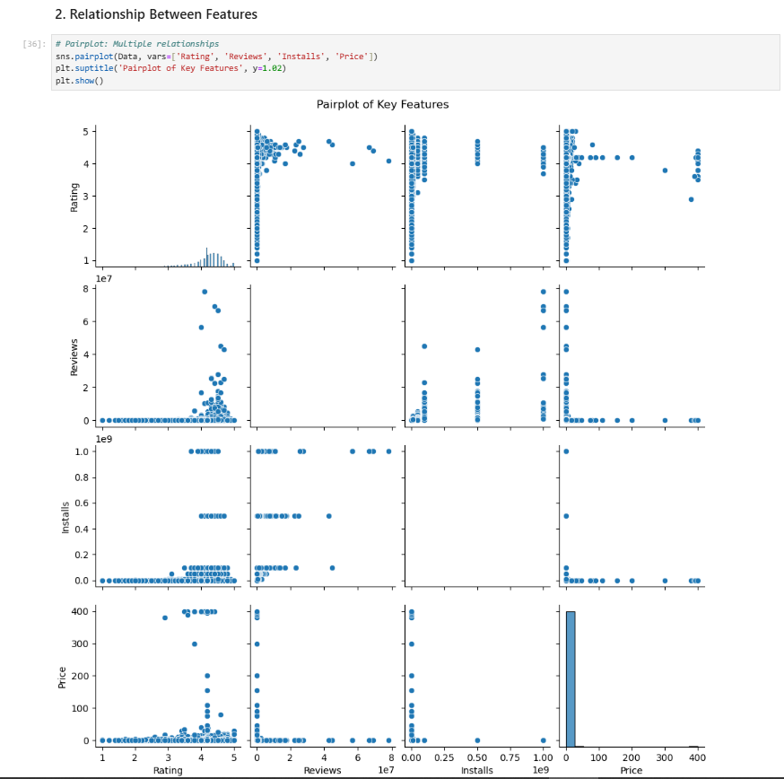
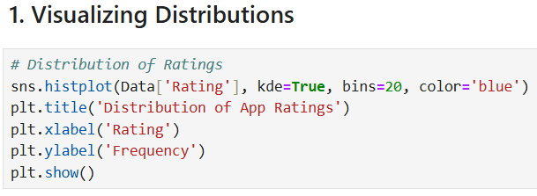
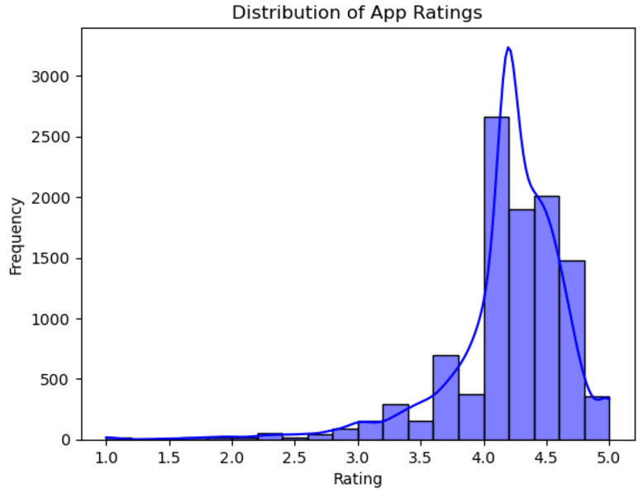

Slide 10
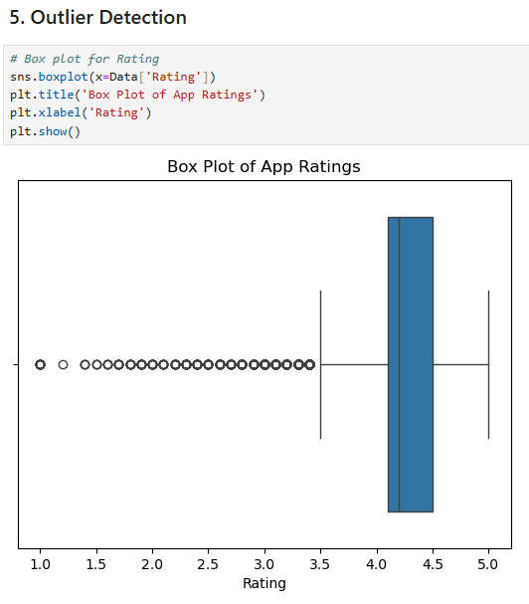
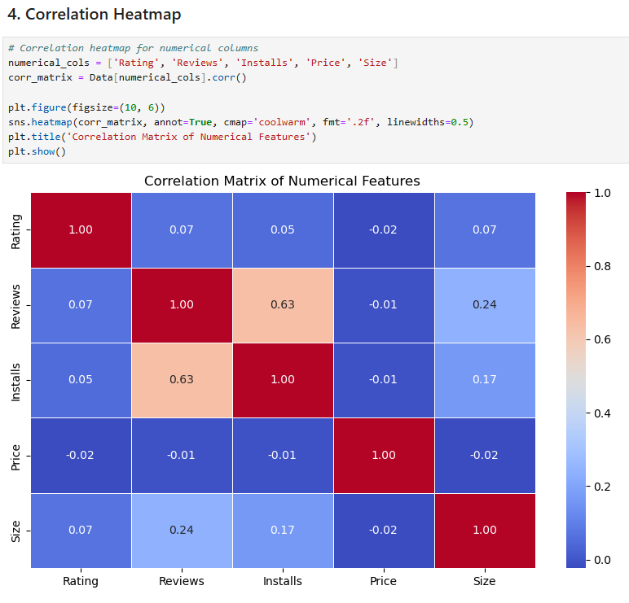

Slide 11
Insights Gained from EDA
Distribution Trends:
Ratings tend to cluster around specific values (e.g., 4.0–4.5).
Category Preferences:
Some app categories have consistently higher ratings (e.g., Education).
Price vs. Installs:
Free apps dominate in terms of installs, but paid apps might have higher ratings.
Outliers:
Certain apps have extremely high review counts, skewing distributions.

Slide 12
6. Prediction Analysis
Predictive analysis involves using historical data to make predictions about future outcomes or behaviors. In this case, we aim to predict app ratings based on features like Reviews, Size, Installs, Price, and other relevant columns in the dataset.
Steps for Predictive Analysis:
Define the Problem
Predict the Rating of an app using other features as predictors.
Feature Selection
Identify which features are most relevant for predicting Rating. Features such as Reviews, Installs, Price, and Size are good candidates.
Data Preparation
Normalize or standardize numerical columns (e.g., Reviews, Installs).
Encode categorical variables like Category and Type.
Model Selection
Use regression algorithms since the target (Rating) is continuous. Examples:
Linear Regression Random Forest Regressor
Gradient Boosting Regressor Model Evaluation

Slide 13
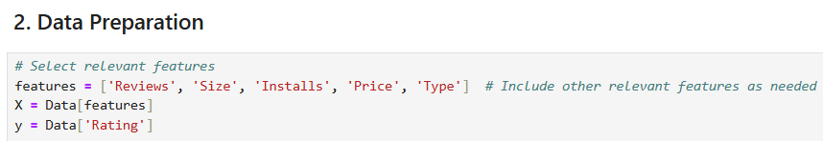
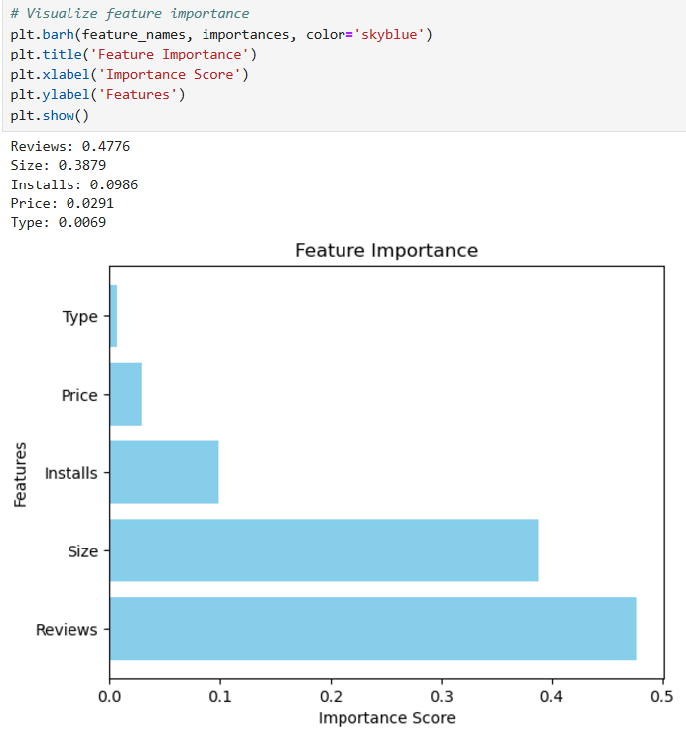
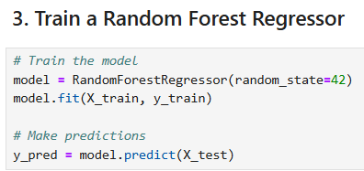
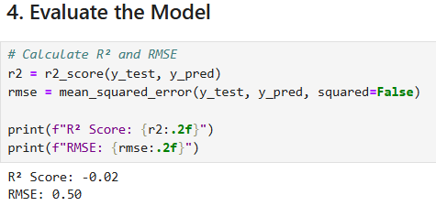

Slide 14
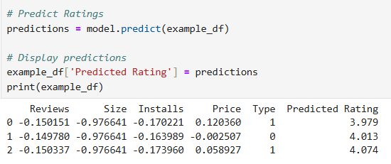
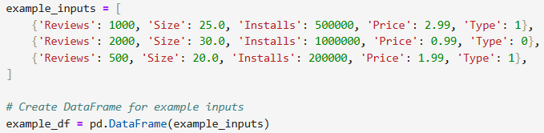
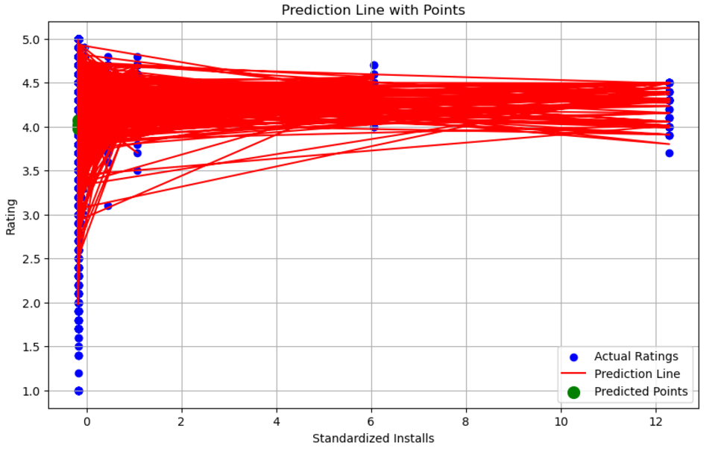

Slide 15
Insights from Predictive Analysis
Model Performance:
R² Score: Indicates how much of the variance in Rating is explained by the features.
RMSE: Quantifies the error in predictions.
Key Features:
Identify which features (e.g., Reviews, Installs) have the most significant impact on Rating.
Practical Implications:
Apps with higher reviews or installs might have better ratings.
Free vs. Paid apps could influence user satisfaction and ratings.
Trend Analysis:
Apps with a balance of moderate price and high installs achieve better ratings.
Larger app sizes might negatively affect ratings, potentially due to performance concerns on lower-end devices.
Scenario Predictions:
Niche apps with high quality but fewer installs might still achieve good ratings if they receive enough positive reviews.
Mass-market apps with many installs but fewer reviews may struggle to achieve high ratings, emphasizing the importance of user feedback.

Slide 16
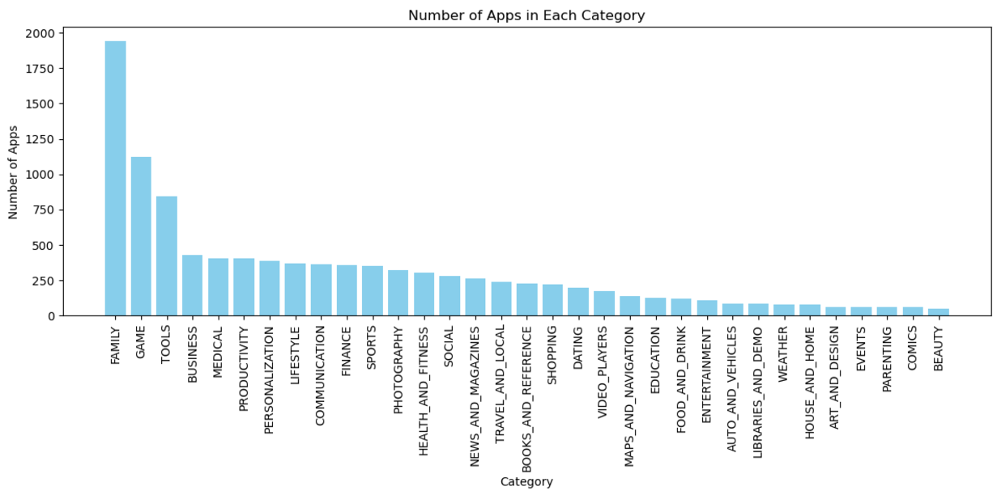
Whole DataSet Analysis

Slide 17
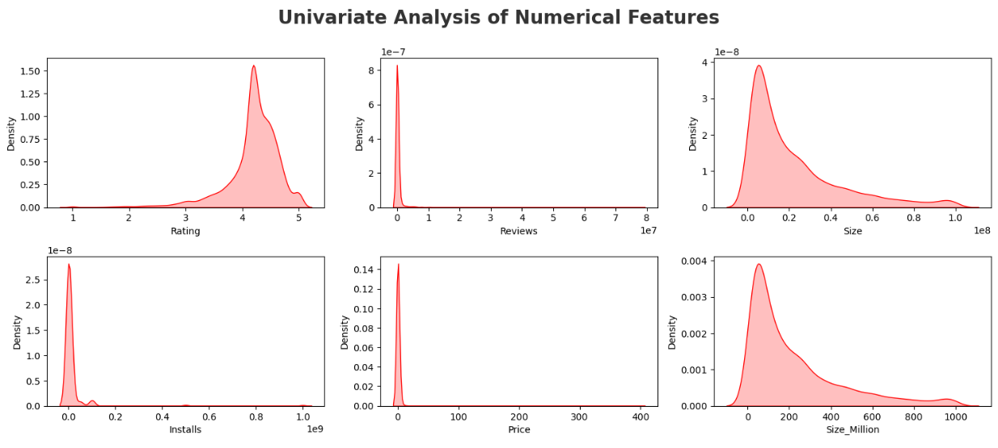
plt.figure(figsize=(15, 15))
plt.suptitle('Univariate Analysis of Numerical Features', fontsize=20, fontweight='bold', alpha=0.8, y=1.)

Slide 18
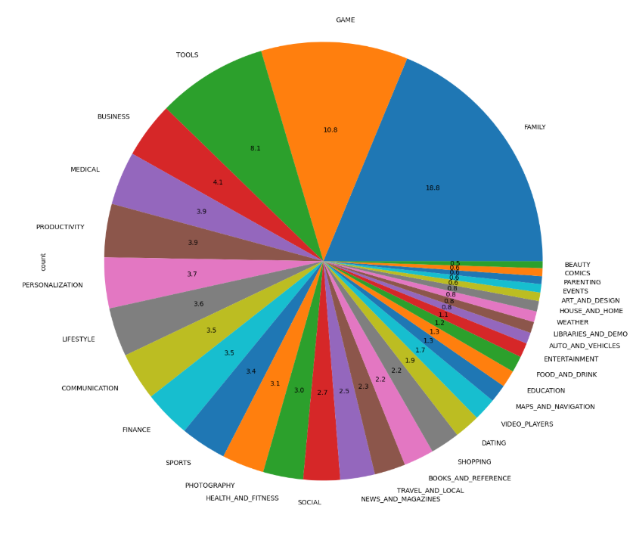
.

Slide 19
THANK YOU

